Slide 1
Inventra – Intelligent Inventory Management System
NITISH CHAUDHARY

Slide 2
MODULE 1
Authentication & Role Control
MODULE 2
Product & Inventory Management System
MODULE 3
Low stock Alerts

Slide 3
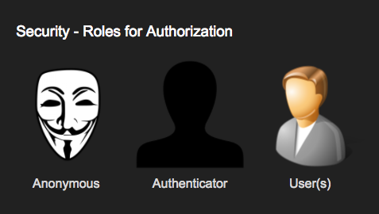
MODULE 1 - What is Authentication?
Authentication means verifying the identity of the user
It checks who is trying to login
User must enter:
Username / Email
Password
USER
LOGIN PAGE
AUTHENTICATION
JWT GENERATED
DASHBOARD

Slide 4
BEHIND THE SCENE -SERVER
FRONTEND
The user enters the User ID / Email and Password in the input fields.
entered details are prepared and sent to the server as a login request.
At this stage, only input is collected — no authentication is done yet.
At this stage, only input is collected — no authentication is done yet.

Slide 5
Request Reaches the Controller Layer
The controller checks whether the required fields are provided or not.
IF VALID THEN SEND TO SERVICE LAYER OTHERWISE GENERATE ERROR
service layer processes authentication logic
Service Layer Handles Business Logic
It calls the Repository layer to fetch the user record from the database.
it match id and password that is in hashed form if match then login success

Slide 6
If authentication is successful, the system creates a Session / Token.
After authentication, authorization begins.
Different users get different access levels:
Admin → Full access
Staff → Limited access
Classes involved
AuthController
AuthService
User
UserRepository
JWTUtility
EmailService (for forgot password)

Slide 7
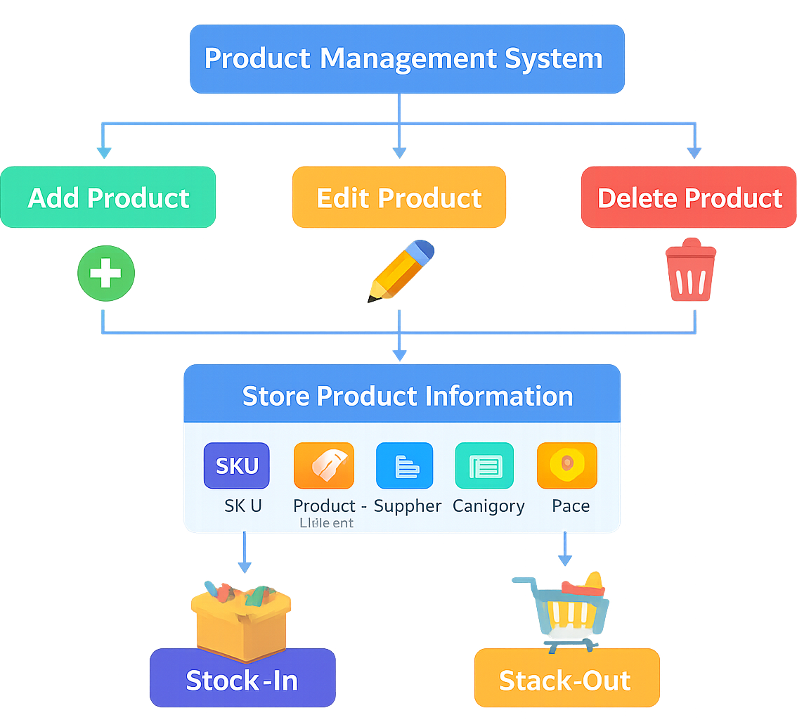
MODULE 2 :-Product & Inventory Management System
This system is designed to manage products and inventory in an organization.
It helps track stock availability, product details, and inventory movement.
Users can add, update, delete, and view products and stock records.
The system reduces manual work, errors, and data loss.
It improves accuracy, efficiency, and real-time monitoring of inventory.

Slide 8
In Step 1, the user selects a specific product or inventory operation, and the system sends this request to the backend for processing.”
The operation be add/update/delete/view product
it validate input is it valid or not
The controller works as the entry point. It validates the request and forwards it to the service layer for business processing.”
service layer check input if alreadt exist then generate error, validate quantity
The Repository layer performs database operations like:
insert –update-view stock – delete product operation
Database Stores Product & Stock Records

Slide 9
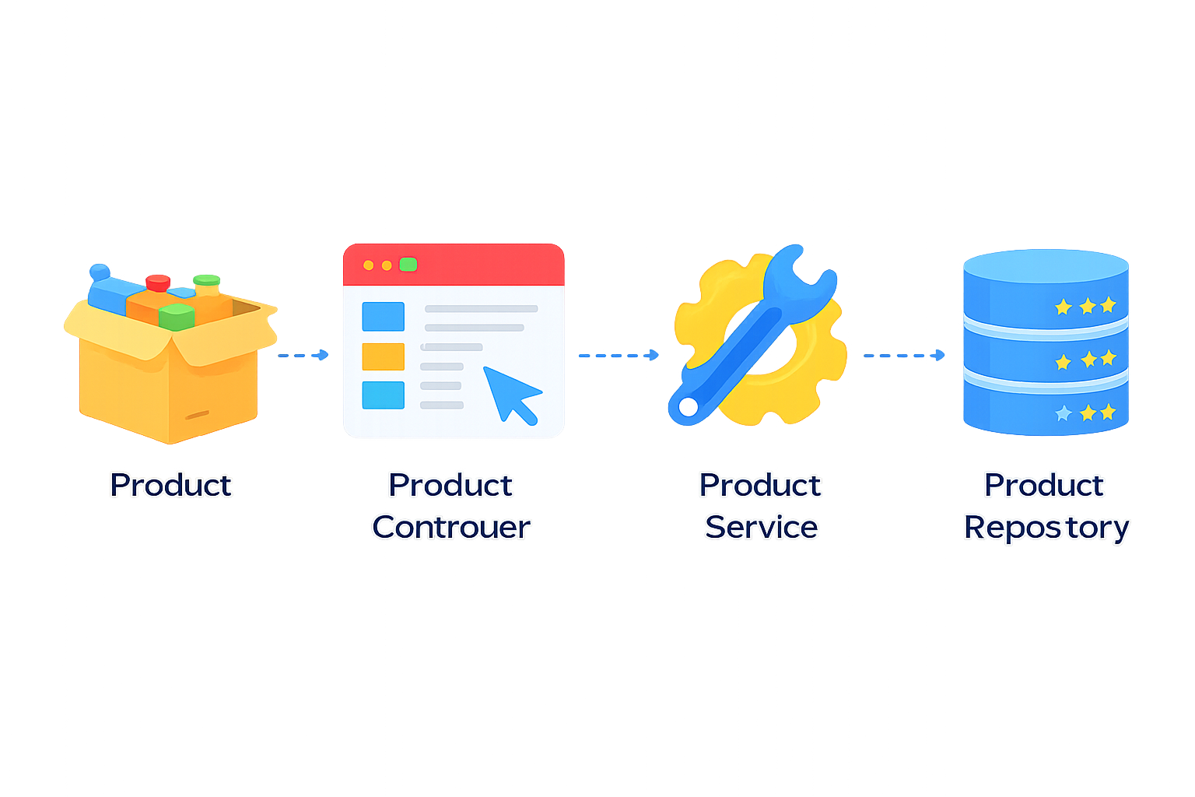
After successfully operation system update inventory status
The backend sends a response to the UI.
Main class is
Product
Product Controller
Product Service
Product Respository

Slide 10
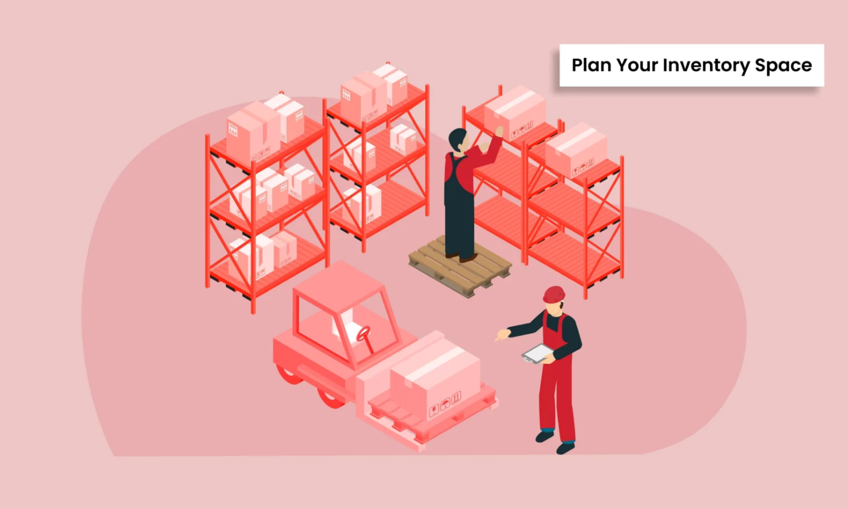
MODULE 3
Low stock Alerts

Slide 11

WHAT IS THE IDEA?
We set a minimum safety level called a threshold.
If stock becomes less than the threshold → system shows ALERT ⚠️
Every product has some quantity in stock.
This helps shop owners refill stock on time.

Slide 12
WHY DO WE NEED THIS?
To avoid out-of-stock problems
To prevent loss in sales
To help store manager take action early
To keep inventory always available

Slide 13
UNDERSTAND THE REQUIREMENT
We first analyzed the problem:
Each product must have a minimum stock level (threshold)
System should continuously track stock
If stock < threshold → Trigger Alert
Alert must appear on:
Dashboard
Email / SMS
Rule: If Stock < Threshold → Raise Alert

Slide 14
DESIGN THE SOLUTION
We designed how the system will work:
Product created → threshold assigned
Stock updates after every transaction
System checks condition
If stock becomes low → alert generated
Alert stored + displayed + notification sent
Stock Update → Check Threshold → Generate Alert → Notify User
Stock Update
Check Threshold
Generate Alert
Notify User

Slide 15
LOW STOCK ALERTS PSEUDOCODE
Class involved
Alert
AlertRepository
AlertService
AlertController

Slide 16
CLASSES IN ALERT SERVICE
Class: Alert
When low stock is detected, the system creates an Alert object.
The object stores alert details such as:
Product ID / Name
Current Stock Quantity
Alert Type (Low Stock)
Alert Time / Date
This object acts as the data structure for the alert.
PSEUDOCODE
class Alert {
Long alertId;
Long productId;
Integer currentQuantity;
Integer reorderLevel;
String alertMessage;
String alertStatus;
}
INVENTORY /ALERT
Alert Object is Created
an Alert object is created to store the details of the low stock alert.”

Slide 17
CLASSES IN ALERT SERVICE
Class: AlertController
Controller Receives Alert Request
The AlertController receives the alert request (from UI or system event).
It validates input such as product id or stock value.
If valid → it forwards the request to the AlertService.
The controller does not contain business logic.
PSEUDOCODE
class AlertController {
/viewAlerts
}
INVENTORY /ALERT
Alert Object is Created
The AlertController works as the entry point and passes the request to the service layer.”

Slide 18
CLASSES IN ALERT SERVICE
Class: AlertService
The AlertService performs the main alert logic:
Compares stock quantity with threshold
Decides whether alert needs to be generated
If condition matches → it creates an Alert object
Then it calls the AlertRepository to save the alert.
PSPSEUDOCODE
class AlertService {
checkLowStock()
createAlert()
}
INVENTORY /ALERT
Alert Object is Created
The AlertService contains the core business logic for generating low stock alerts.”

Slide 19
CLASSES IN ALERT SERVICE
Class: AlertRepository
The AlertRepository communicates with the database.
It performs operations like:
Save Alert
Fetch Alerts
Retrieve latest alert records
It returns the saved alert back to the service layer.
PSEUDOCODE
class AlertRepository {
save(Alert a)
findAll()
}
INVENTORY /ALERT
Alert Object is Created
The AlertRepository is responsible only for database operations related to alerts.

Slide 20
Inventory Alerts- Database Design
This section defines the database schema used to store inventory alert information.
Table
CREATE TABLE alerts (
alert_id BIGINT PRIMARY KEY AUTO_INCREMENT,
product_id BIGINT,
current_quantity INT,
reorder_level INT,
alert_message VARCHAR(255),
alert_status VARCHAR(30), -- OPEN, ACKNOWLEDGED, CLOSED
created_at TIMESTAMP DEFAULT CURRENT_TIMESTAMP,
FOREIGN KEY (product_id) REFERENCES products(product_id)
);
INVENTORY /ALERT
Alert Object is Created

Slide 21
THANKU

